Slide 1
1 -Looking for the data set
1
First, I looked for the data set in different platforms and I performed EDA on them in order to test which one was more appropriate to fulfil the requirements of this CA.
2
2 –Data Preparation and EDA
In this stage my goal was to understand the structure of the database and extract relevant information. Subsequently, I went to the data preparation stage, where I transformed the categorical variables into numerical ones to be able to include them in the algorithm,
Contributions
Ayllin Bukovic
3
3 –Apply cluster algorithms
My contributions were carried out in the following stages:
I applied different cluster algorithms in order to find patterns related to the consumption of energy and reach our main goal. I also used different models such as K-Means, K-Medoids, DBSCAN, and Fuzzy C-means and Hierarchical Clustering
4
4 –Evaluation of the algorithms
Once I applied all these models, I evaluated their performance by applying the Silhouette Coefficient method for each algorithm. The goal of this was to understand and numerically determine which of our algorithms was a better fit for the clusters.

Slide 2




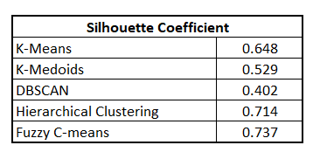
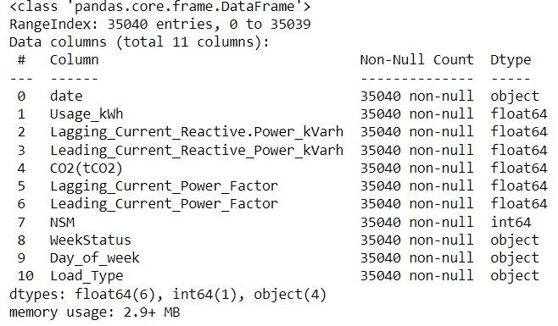
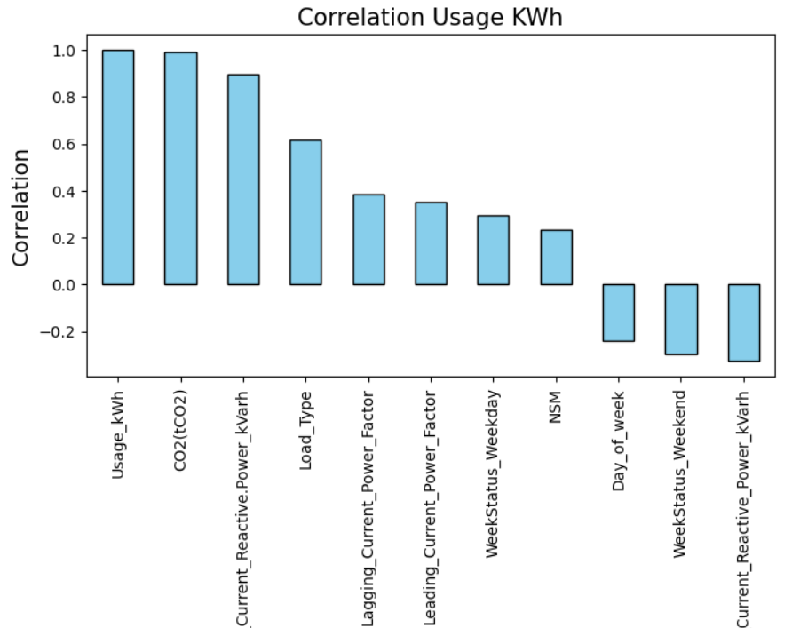
Key Findings
Data experimentation and important decisions made at each stage
Looking for the data set
Data Preparation and EDA
Apply cluster algorithms
Evaluation of the algorithms
At this stage, It was necessary perform experimentation with different data set, in order to find the right one. When we found the correct one, as a group we discuss the main goal and what would be our motivation. The data set had 35040 entries and 11 columns
The data was pretty clean but the most important action of this stage was to change the categorical variables to numerical ones, I used two different methods depending on the characteristics of the data. Also a a correlation matrix was done, to understand which variables were related with the energy consumption. All of the analysis help me to decide to use “Usage” and “Lagging Power” for the clustering models
I proceeded to apply different cluster algorithms in order to find patterns related to the consumption of energy. I started with 2 dimensions, using the Usage and the lagging power. First I tried K-means and I got clear clusters. I used the elbow method in order to find the optimal number of clusters.. Moreover, I also used different models such as K-Medoids, DBSCAN, Fuzzy C-means, and Hierarchical Clustering in order to experiment with and understand the behavior of the algorithms with different hyperparameters.
I find nice clusters using the K-Means, Fuzzy C-means, and Hierarchical Clustering, but we needed to evaluate them not just in a visual way. So we went to the next step.
II decided to use the Silhouette Coefficient to validate the clustering.of each method
Using this technic it was very easy to validate what we could see just visually. The Fuzzy C-Means performed In a better way, followed by the Hierarchical Clustering.

Slide 3
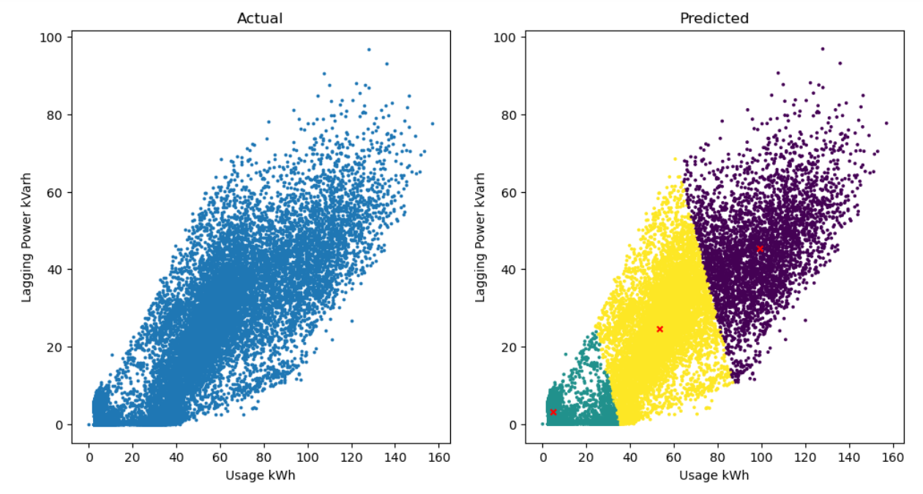
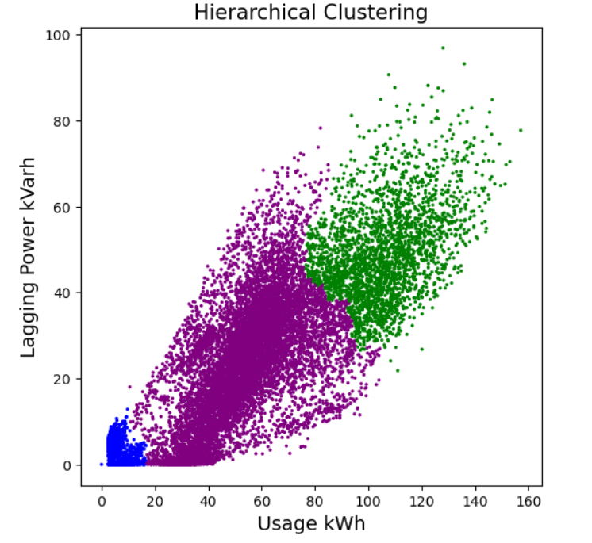
Conclusions
Results found and discussion
Using clustering algorithms was very useful to find patterns among the data, we had the main objective of understanding patterns that would help the company to reduce the energy consumption.
The best model for this was the Fuzzy C-means, which created nice clusters and showed the direct correlation between the Lagging Power and the Usage of energy. We created 3 clusters, related to Light Load, Medium Load, and High Load, we found that if we can reduce the lagging power in the industry, we also reduce the Energy Usage.
Following we can see the two best models:
Fuzzy C-means
Hierarchical clustering
We can see that both look similar, the Fuzzy C means considered more data points in a group with less energy consumption than the Hierarchical clustering, this could be because this model is more flexible.
Hierarchical clustering involves creating clusters that have a predetermined ordering from top to bottom. That is why we can see that works really well in this case, because we have 3 levels of energy consumption
Silhouette Coefficient: 0.74
Silhouette Coefficient: 0.71

